Slide 1
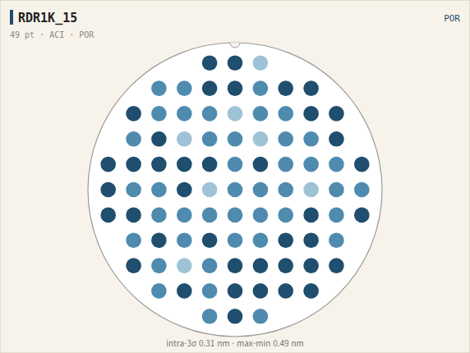
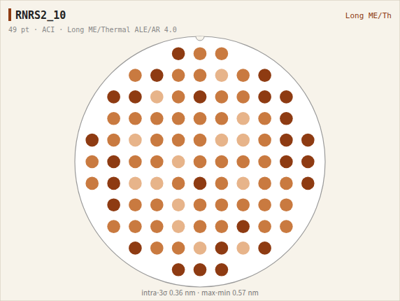
VA ACI CD wafer map
Long ME/Thermal ALE/AR 4.0: ACI 9.8/8.3 (POR 8.8/8.3), edge 편차 POR 수준
LogicTD 마도윤

Slide 2

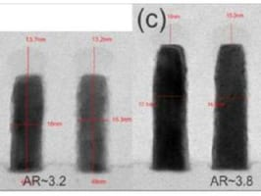

KVKB RNRS2.6B ET results
●
평가목적 ; VA Ru etch / ALE / Line AR split 평가
●
평가결과 ;
Profile (Ru etch / ALE split, POR 대비)
- RIE+IBE trim/Thermal ALE/AR 4.0 (RNRS2_5): AASI/ASEI Δ+0.24/+0.16, ACI 8.7/8.3로 POR과 근접
HAR Ru line TEM, AR 3~6 (imec) / Ru HAR line TEM / 16nm pitch Ru line TEM (imec)
- Long ME/Thermal ALE/AR 4.0 (RNRS2_10): AASI/ASEI Δ+0.99/+1.08로 변동 최대, ACI A측만 9.8으로 POR 대비 +1.0 확대 (B측 8.3 동등)
WAFER |  | POR (RDR1K_15) | RNRS2_5 | RNRS2_10 | RNRS2_25 | RNRS2_24
Ru etch |  | O2/Cl2 RIE | RIE+IBE trim | Long ME | Segmented E-C | Long ME
ALE |  | - | Thermal ALE | Thermal ALE | - | Thermal ALE
Line AR |  | AR 2.0 | AR 4.0 | AR 4.0 | AR 3.0 | AR 3.0
AASI |  | 23.22 | 23.46 | 24.21 | 23.42 | 24.43
ASEI |  | 8.6 | 8.7 | 9.6 | 8.7 | 9.4
ACI |  | 8.8/8.3 | 8.7/8.3 | 9.8/8.3 | 8.9/8.4 | 9.7/9.1
CMBSRP | Short | 93% | 60% | 92% | 91% | 12%
VCHN | Open | 100% | 96% | 96% | 96% | 97%
 | Short | 100% | 97% | 99% | 97% | 97%
V1 Rc (Ω) |  | 64.4 | 64.8 | 68.1 | 66.1 | 61.5
VA Rc (Ω) |  | 61.0 | 64.0 | 66.4 | 59.2 | 57.0
- Segmented E-C/AR 3.0 (RNRS2_25): AASI/ASEI Δ+0.20/+0.12, ACI 8.9/8.4로 POR과 근접
- Long ME/Thermal ALE/AR 3.0 (RNRS2_24): AASI/ASEI Δ+1.20/+0.84, ACI 9.7/9.1로 전 구간 +0.9~0.9 확대
Yield (CMBSRP / VCHN Open·Short)
- RIE+IBE trim/Thermal ALE/AR 4.0: V1 Rc 64.8Ω(+1%), VA Rc 64.0Ω(+5%), CMBSRP Short 60%(-33%p), VCHN Open 96%(-4%p) → 고AR 식각 bottom 미분리 → bridge성 short 추정
- Long ME/Thermal ALE/AR 4.0: V1 Rc 68.1Ω(+6%), VA Rc 66.4Ω(+9%), CMBSRP 92%로 POR 동등, VCHN Open 96%(-4%p) → 전 item POR 동등
- Segmented E-C/AR 3.0: V1 Rc 66.1Ω(+3%), VA Rc 59.2Ω(-3%), CMBSRP 91%로 POR 동등, VCHN Open 96%(-4%p) → 전 item POR 동등
- Long ME/Thermal ALE/AR 3.0: V1 Rc 61.5Ω(-4%), VA Rc 57.0Ω(-6%), CMBSRP Short 12%(-81%p), VCHN 97/97%로 POR 동등 → 장시간 plasma 로 SiN HM 산화 팽창 → Ru line bottom bridge, short 지배적
결론
- Long ME/Thermal ALE/AR 4.0·Segmented E-C/AR 3.0 는 POR 대비 전 항목 동등 → 후보 조건, RIE+IBE trim/Thermal ALE/AR 4.0·Long ME/Thermal ALE/AR 3.0 는 Short 열화
- Long ME/Thermal ALE/AR 3.0 CD targeting 후 short 재확인 필요 — EBAC 국소화 병행
- Ru line bottom bridge 여부 TEM 확인 예정
LogicTD 마도윤

Slide 3
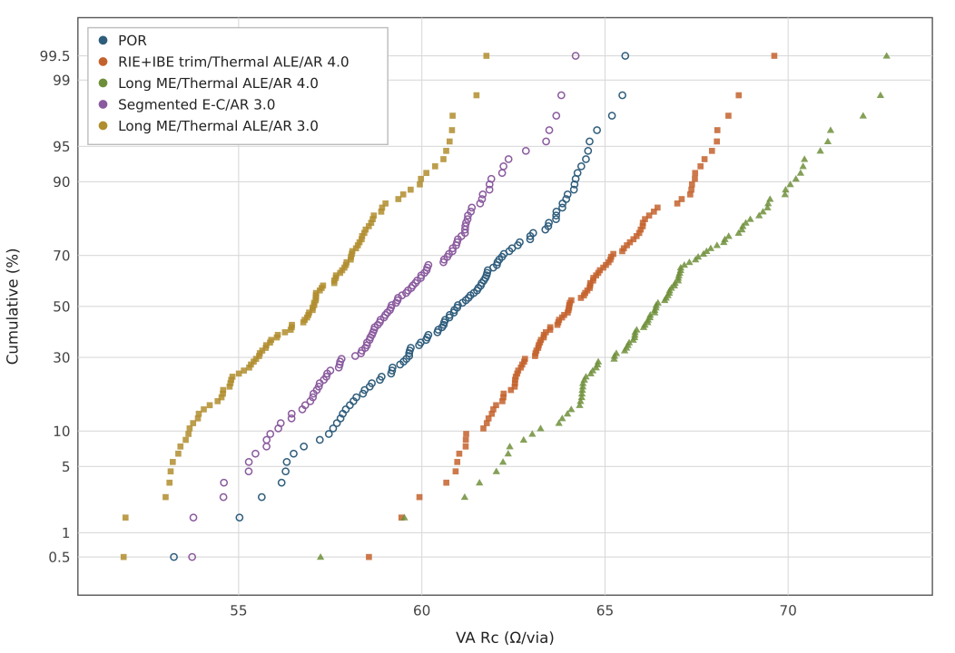
VA Rc cumulative distribution
POR median 61.0Ω
RIE+IBE trim/Thermal ALE/AR 4.0 median 64.0Ω (+5.0%)
Long ME/Thermal ALE/AR 4.0 median 66.4Ω (+8.9%)
Segmented E-C/AR 3.0 median 59.2Ω (-3.0%)
Long ME/Thermal ALE/AR 3.0 median 57.0Ω (-6.5%)
LogicTD 마도윤

Slide 4
VA ET fail die summary
WAFER |  | POR (RDR1K_15) | RNRS2_5 | RNRS2_10 | RNRS2_25 | RNRS2_24
CMBSRP | Open | 0 | 0 | 0 | 1 | 0
 | Short | 3 | 20 | 4 | 4 | 43
VCHN | Open | 0 | 2 | 2 | 2 | 1
 | Short | 0 | 1 | 0 | 1 | 1
Total die |  | 49 | 49 | 49 | 49 | 49
RIE+IBE trim/Thermal ALE/AR 4.0: Short fail die 집중 (CMBSRP)
Long ME/Thermal ALE/AR 3.0: Short fail die 집중 (CMBSRP)
LogicTD 마도윤

Slide 5
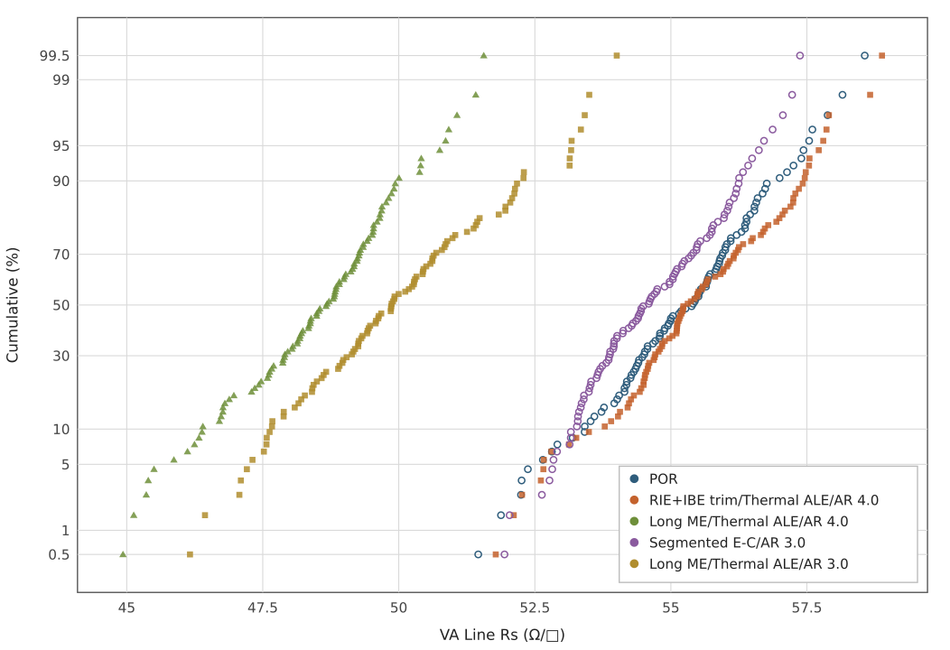
VA Line Rs cumulative distribution
POR median 55.40
RIE+IBE trim/Thermal ALE/AR 4.0 median 55.27 (-0.2%)
Long ME/Thermal ALE/AR 4.0 median 48.67 (-12.1%)
Segmented E-C/AR 3.0 median 54.54 (-1.5%)
Long ME/Thermal ALE/AR 3.0 median 49.86 (-10.0%)
LogicTD 마도윤

